Slide 1
SOLAR TRACKING SYSTEM
harnessing maximum energy from the sun………
(By 10th group members)

Slide 2
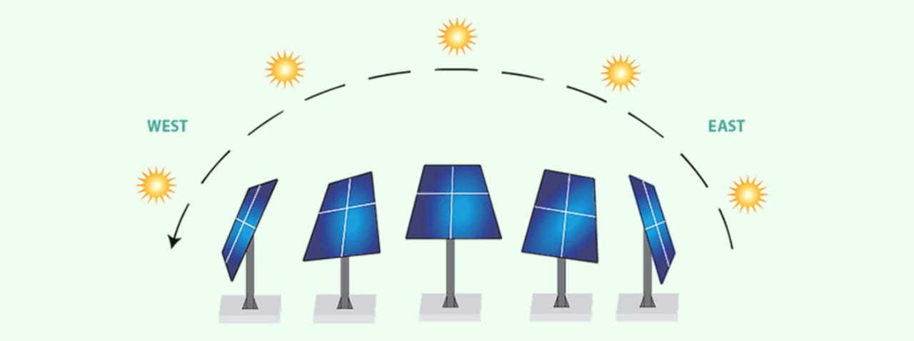
INTRODUCTION TO SOLAR TRACKING SYSTEM
A solar tracking system is a mechanical device that orients solar panels or other solar applications towards the sun to maximize the amount of solar radiation they can collect. This improves energy efficiency by ensuring the panels are always perpendicular to the sun's rays

Slide 3
A vital component in the global transition to a sustainable future, has become a clean, abundant, and accessible source of power. However, traditional solar panels, fixed in a single position, often fall short in harnessing the full capacity of solar energy. This limitation has led to the development of Solar Power Tracking Systems, which adjust the angle and orientation of solar panels to track the sun's movement throughout the day, maximizing energy production and efficiency. By optimizing energy output, reducing carbon footprint, increasing return on investment, and improving system efficiency, Solar Power Tracking Systems have become a crucial technology in the solar energy sector.
A solar tracking system is a technological solution designed to optimize energy production from solar panels by tracking the movement of the sun and adjusting the panel's angle accordingly. This innovative system enables solar panels to capture the maximum amount of solar energy available, increasing energy output and reducing energy waste.By harnessing the power of the sun more efficiently, solar tracking systems have become a vital component in the transition to renewable energy sources, supporting a sustainable future for our planet

Slide 4
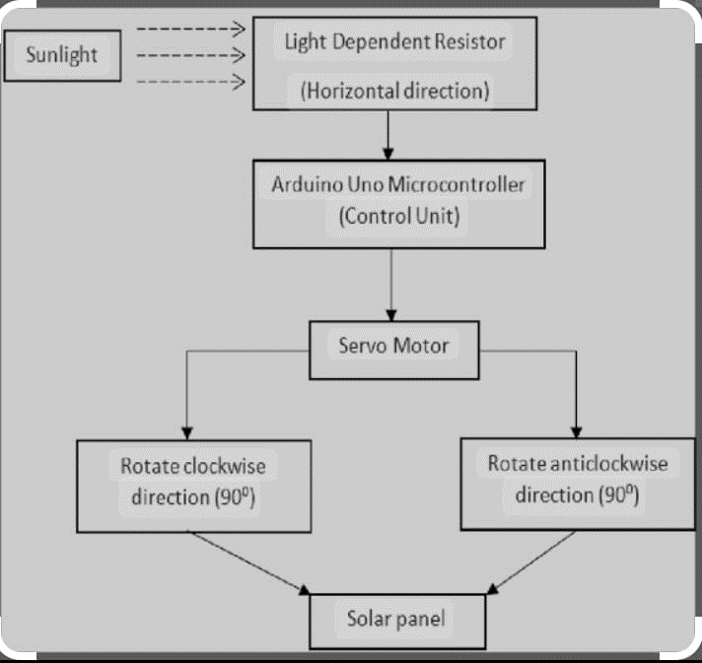
solar tracking system tracks the position of the sun and maintains the solar photovoltaic modules at an angle that produces the best power output. Several solar tracking principles and techniques have been proposed to track the sun efficiently. The idea behind designing a solar tracking system is to fix solar photovoltaic modules in a position that can track the motion of the sun across the sky to capture the maximum amount of sunlight. Tracker system should be placed in a position that can receive the best angle of incidence to maximize the electrical energy output. Designing such device to produce electrical energy is interesting and important.

Slide 5
A solar tracker is any device that tracks the movement of the sun across the sky. These have many applications, but for the energy industry they are most commonly used for solar projects, both CSP and PV. CSP is concentrated solar power, this is technology that uses mirrors or reflective panels to concentrate the rays of the sun at a certain point which will become superheated and can be used to generate electricity. Trackers for PV orient the photo voltaic panels to continually receive the most direct irradiation from the sun. Since the power production from PV systems depends on the irradiation received by the panels, such a tracking system is very helpful in maximizing their output.
The trackers required for CSP are much more sensitive and exacting than the trackers required for PV—often within a tenth of a degree of accuracy, while those for PV panels can be less exacting

Slide 6
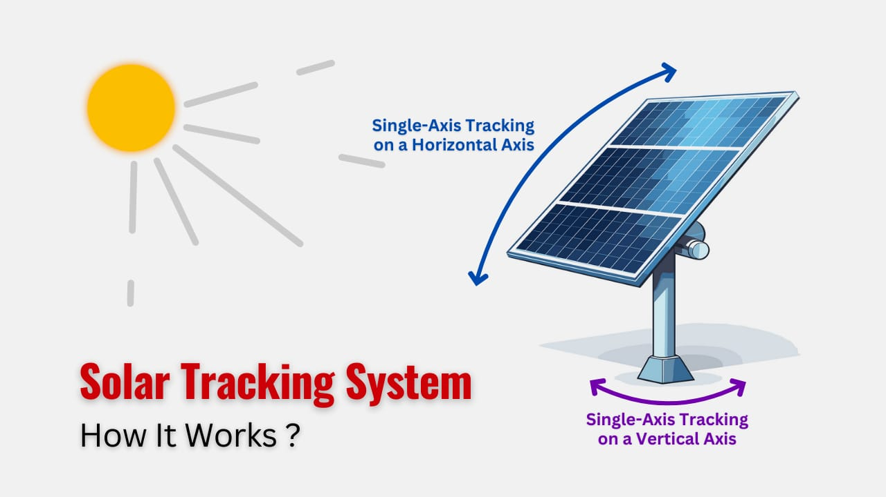
HOW IT WORKS?
WORKING:
Active solar tracking system is the system that determines the position of the sun path in the sky during the day with the sensors.
These sensors trigger the motor or actuator to move the drive system to the system towards the sun throughout the day.

Slide 7
PROCESS OF WORKING
Sun Detection: Solar tracking systems use sensors to detect the sun's position and intensity. These sensors can be: - Light Dependent Resistors (LDRs) - Photodiodes - GPS and astronomical data
Signal Processing: The control unit processes the sensor data and calculates the optimal panel angle and orientation. This is done using algorithms that take into account: - Sun's position (azimuth and elevation) - Panel's initial position - Panel's angular range - Latitude and longitude
Motor Activation: The control unit sends signals to the motors to adjust the panel's angle and orientation. The motors can be: - Stepper motors - Servo motors - DC motors
Panel Movement: The motors move the panels to the calculated position, ensuring optimal energy production. This can be done in: - Single-axis tracking (east-west movement) - Dual-axis tracking (east-west and north-south movement)
Continuous Monitoring: The sensors continuously monitor the sun's position and adjust the panels accordingly. This ensures: - Real-time tracking - Optimal energy production

Slide 8
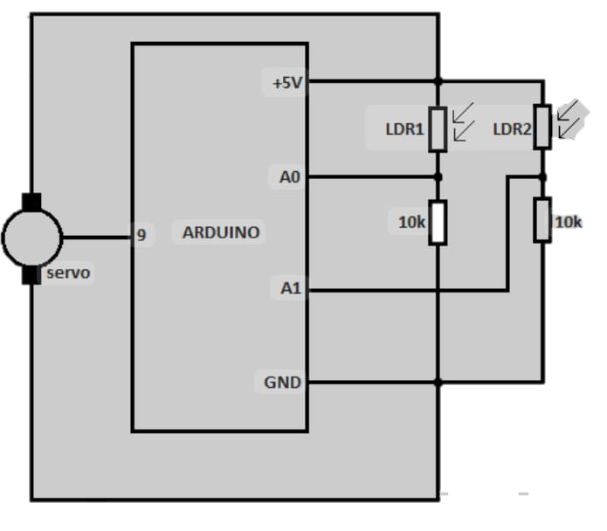
6.Tracking Algorithm: The control unit uses algorithms to predict the sun's movement and adjust the panels proactively.
These algorithms can be:
- Astronomical algorithms (using astronomical data)
-Geographical algorithms (using geographical data)
Solar time algorithms (using solar time data)
- Intelligent algorithms (using machine learning and data analysis)
7. Energy Optimization: The system optimizes energy production by constantly adjusting the panels to face the sun.
This results in:
- Increased energy production
- Reduced energy losses
- Improved system efficiency
By continuously tracking the sun, solar tracking systems can increase energy production by up to 45% compared to fixed-tilt systems

Slide 9
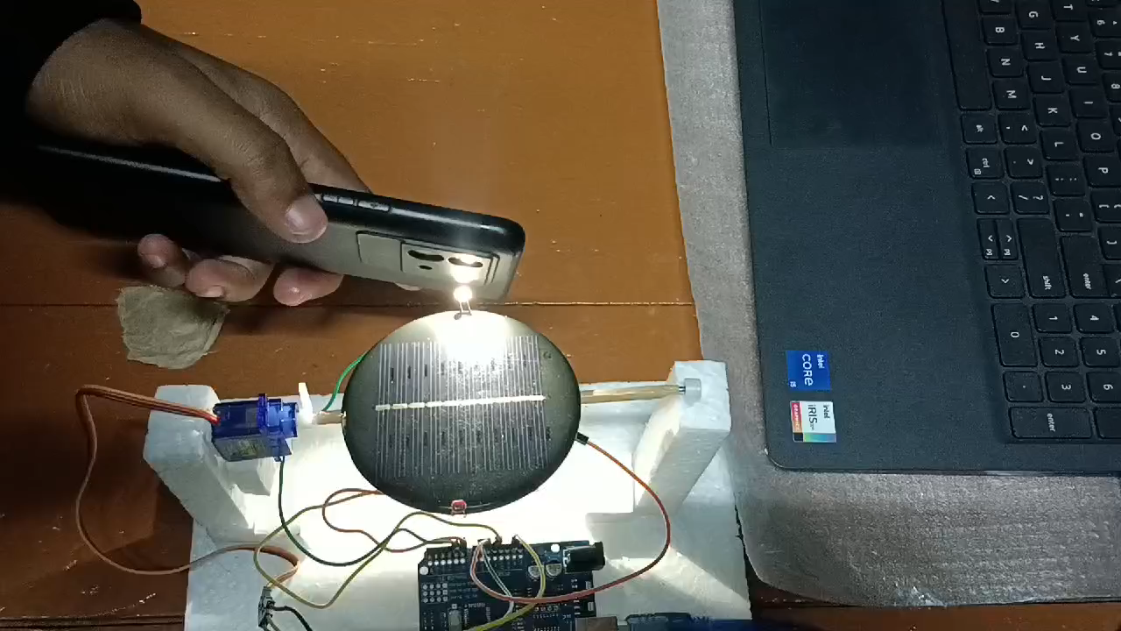

Slide 10
COMPONENTS NEEDED FOR
SOLAR TRACKING SYSTEM
Light Depedent Resistor(LDR)
Servo Motor
Audino Uno(Micro controller)
Jumpers
Solar Panel
Resistor

Slide 11
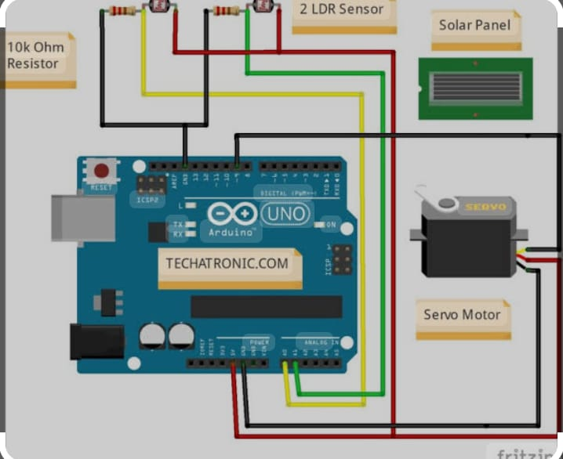

Slide 12
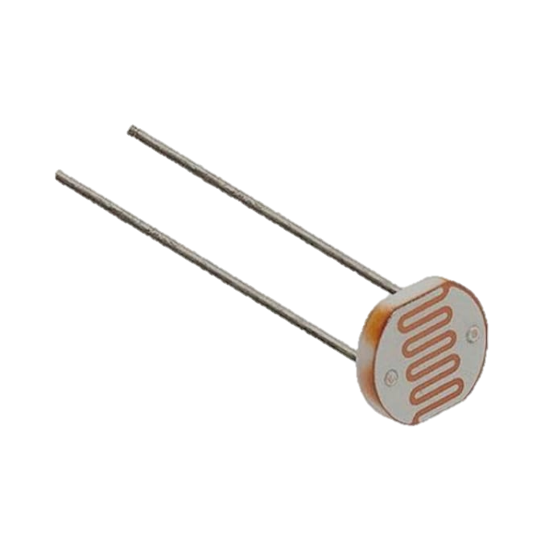
1.LDR(LIGHT DEPEDENT RESISTOR)
A photoresistor (also known as a light-dependent resistor, LDR, or photo-conductive cell) is a passive component that decreases in resistance as a result of increasing luminosity (light) on its sensitive surface, in other words, it exhibits photoconductivity.
A photoresistor can be used in light-sensitive detector circuits and light-activated and dark-activated switching circuits acting as a semiconductor resistance. In the dark, a photoresistor can have a resistance as high as several megaohms (MΩ), while in the light, it can have a resistance as low as a few hundred ohms.
If incident light on a photoresistor exceeds a certain frequency, photons absorbed by the semiconductor give bound electrons enough energy to jump into the conduction band. The resulting free electrons (and their hole partners) conduct electricity, thereby lowering resistance

Slide 13
Light dependent resistors (LDRs) are used in solar tracking systems to maximize solar energy collection by keeping solar panels oriented towards the sun. LDRs are light sensitive devices that decrease in resistance when light falls on them.
Here's how LDRs are used in solar tracking systems:
Detect light levels: LDR sensors detect light levels and send data to a microcontroller.
Determine the sun's position: The microcontroller compares the LDR readings to determine the sun's position relative to the solar panels.
Rotate the panels: A servo motor rotates the panels based on the LDR sensor readings so that they remain perpendicular to the incoming sunlight.

Slide 14
In single axis systems, two or three LDRs are mounted on either side of the panel. In dual axis systems, four LDRs can be used to detect sunlight and signal an Arduino to control servo motors.
Light dependent resistors is a one type of resistor whose resistance
varies depending on the amount of light falling on its surface.
When the light falls on the resistor, then the resistance changes.
LDR resistors are often used in many circuits where it is required to sense the
presence of light. These resistors have a variety of functions and resistance. For instance, when the LDR is in darkness, then it can be used to turn ON a light or to turn OFF a light when it is in the light. A typical light dependent resistor has
a resistance in the darkness of 1MOhm, and in the brightness a resistance of a couple of Kohm.

Slide 15
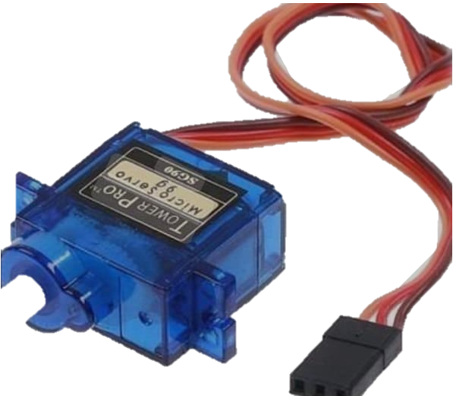
2.SERVO MOTORS
A servo motor is a rotational or translational motor to which power is supplied by a servo amplifier and serves to apply torque or force to a mechanical system, such as an actuator or brake. Servo motors allow for precise control in terms of angular position, acceleration, and velocity. This type of motor is associated with a closed-loop control system. A closed-loop control system considers the current output and alters it to the desired condition. The control action in these systems is based on the output of the motor. It uses a positive feedback system to control the motion and final position of the shaft. AC servo motors can handle higher current surges and are thus more commonly found in heavy industrial machinery. ISL’s DC Servo Motors are best suited for smaller applications and have excellent control-ability and feedback.

Slide 16
In a servo motor speed is determined by the frequency of the applied voltage and the number of magnetic poles. Common applications include Collaborative robotics, Conveyor belts, Automatic door openers, CNC turning/milling machines, and Automation systems. Discover how incorporating a servo motor into your application will help increase it’s efficiency.
Servo motors play a crucial role in solar tracking systems, enabling precise and accurate movement of solar panels to track the sun's position.
Here's how servo motors are used in solar tracking systems:
Panel Movement
Precise Control
High Torque
Positioning
Automation

Slide 17
Benefits of using servo motors in solar tracking systems:
Increased energy production
Improved system efficiency
Precise panel movement
High reliability
Customizable tracking algorithms
Types of servo motors used in solar tracking systems:
DC Servo Motors
AC Servo Motors
Stepper Servo Motors
Brushless Servo Motor
By utilizing servo motors, solar tracking systems can optimize energy production, reduce maintenance, and enhance overall performance.

Slide 18
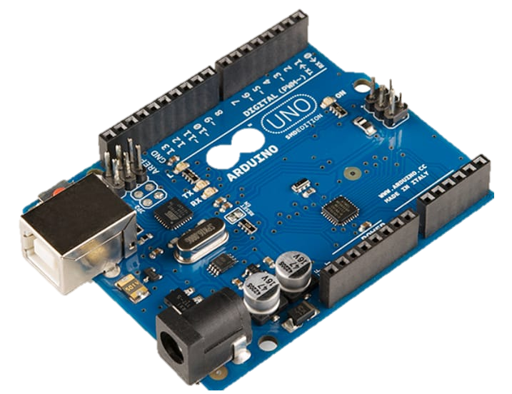
3.ARDUINO UNO
The Arduino Uno is an open-source microcontroller board based on the Microchip ATmega328P microcontroller (MCU) and developed by Arduino.cc and initially released in 2010.The microcontroller board is equipped with sets of digital and analog input/output (I/O) pins that may be interfaced to various expansion boards (shields) and other circuits.The board has 14 digital I/O pins (six capable of PWM output), 6 analog I/O pins, and is programmable with the Arduino IDE (Integrated Development Environment), via a type B USB cable. It can be powered by a USB cable or a barrel connector that accepts voltages between 7 and 20 volts, such as a rectangular 9-volt battery.

Slide 19
It has the same microcontroller as the Arduino Nano board, and the same headers as the Leonardo board
Arduino Uno is a popular microcontroller board that can be used in solar tracking systems to control and monitor the movement of solar panels.
Here are some ways Arduino Uno can be used in solar tracking systems:
Panel Control
Sensor Integration
Tracking Algorithm
Motor Driver
Data Logging
Remote Monitoring
Automatic Adjustment

Slide 20
Benefits of using Arduino Uno in solar tracking systems:
Cost-effective
Easy to program and use
Flexibility and customization
Real-time monitoring and control
Improved system efficiency
Increased energy production
Note: Arduino Uno is a popular choice for solar tracking systems due to its ease of use, flexibility, and cost-effectiveness. However, other microcontrollers like Arduino Mega, ESP32, or Raspberry Pi can also be used depending on the system's requirements.

Slide 21
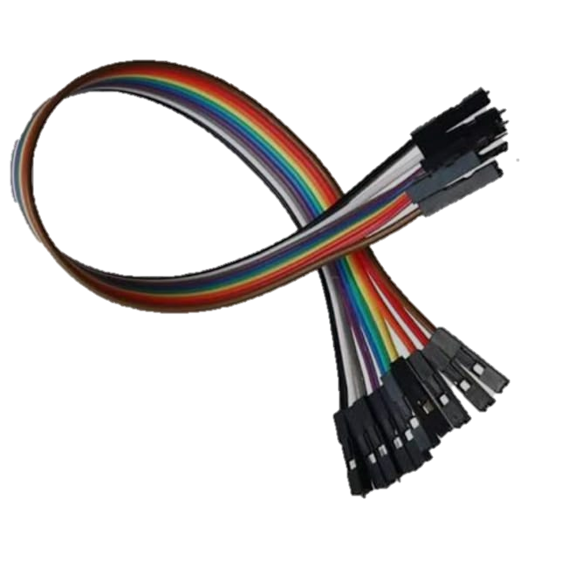
4.JUMPER WIRES
Jumper wires are used to connect components, sensors, and modules in a solar tracking system. Here are some specific uses of jumper wires:
Connecting sensors: Jumper wires are used to connect sensors such as light dependent resistors (LDRs), photodiodes, or temperature sensors to the control unit.
Motor control: Jumper wires are used to connect the control unit to the motor driver, which controls the movement of the solar panels.
Power supply: Jumper wires are used to connect the power supply to the control unit, sensors, and motors.

Slide 22
Signal transmission: Jumper wires are used to transmit signals between components, such as from the control unit to the motor driver.
Debugging: Jumper wires can be used to temporarily connect or disconnect components for debugging purposes.
Prototyping: Jumper wires are often used in prototyping to quickly test and validate circuit designs.
Connecting modules: Jumper wires are used to connect modules such as GPS, Wi-Fi, or Bluetooth modules to the control unit.

Slide 23
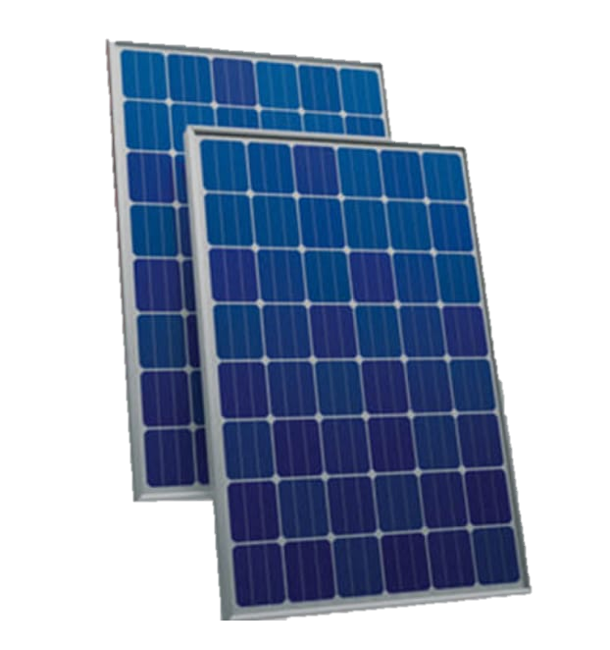
5.SOLAR PANELS
A solar panel is a device that converts sunlight into electricity by using photovoltaic (PV) cells.
PV cells are made of materials that produce excited electrons when exposed to light.
The electrons flow through a circuit and produce direct current (DC) electricity, which can be used to power various devices or be stored in batteries. Solar panels are also known as solar cell panels, solar electric panels, or PV modules.

Slide 24
Solar panels are a crucial component of a solar tracking system, and their uses can be detailed as follows:
Energy Generation: Solar panels convert sunlight into electrical energy, which is then used to power the tracking system and other connected devices
Tracking System Powering: Solar panels provide the necessary power to operate the tracking system's motors, sensors, and control unit.
Charging Batteries: Excess energy generated by the solar panels can be used to charge batteries, which can then be used to power the tracking system during periods of low sunlight or at night.
System Efficiency: Solar panels help optimize system efficiency by providing real-time data on solar radiation, temperature, and other environmental factors.
Panel Cleaning: Some solar tracking systems use solar panels to power panel cleaning systems, ensuring optimal energy production.
Monitoring and Control: Solar panels can be used to power monitoring and control systems, enabling real-time tracking of system performance and optimization.

Slide 25
7. Energy Storage: Solar panels can charge energy storage systems, such as
batteries, to provide a backup power source during periods of low sunlight
or power outages.
Grid Connection: Solar panels can be connected to the grid, allowing excess energy to be sold back to the utility company and offsetting energy costs.
Off-Grid Power: Solar panels can provide off-grid power for remote solar
tracking systems, enabling operation in areas without access to the grid
10. System Expansion
By utilizing solar panels in these ways, solar tracking systems can optimize energy production, reduce costs, and increase overall efficiency.

Slide 26
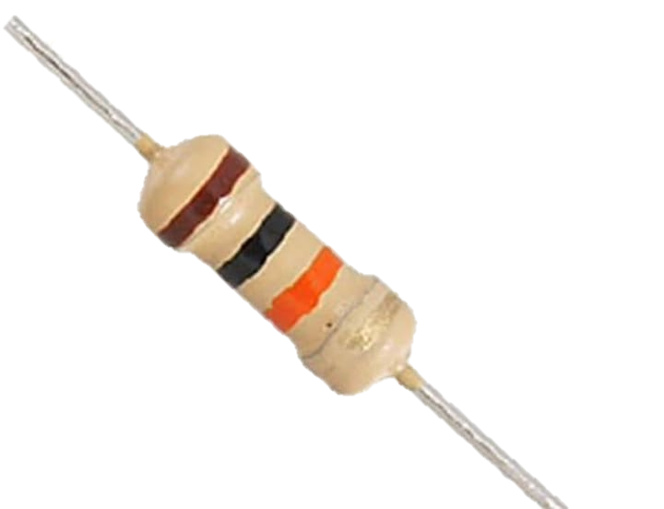
6.RESISTORS(10kOHM)
In a solar power tracking system, resistors play several key roles. They are used in voltage dividers to scale down the solar panel's voltage to a level that can be read by microcontrollers or ADCs (Analog-to-Digital Converters). This is crucial for monitoring the panel's performance and adjusting its orientation.
Resistors also limit current to LEDs or other indicator components, ensuring they operate safely. Additionally, they can be part of RC (resistor-capacitor) filters to smooth out sensor signals and reduce noise. Overall, resistors are essential for precise voltage measurement, signal conditioning, and safe operation of the system.

Slide 27
CODE USED FOR ARDUINO UNO
//Include the servo motor library
#include<Servo.h>
//Define the LDR sensor pins
#define LDR1 A0
#define LDR2 A1
//Define the error value. You can change it as you like
#define error 10
//Starting point of the servo motor
int Spoint = 90;
//Create an object for the servo motor
Servo servo;
void setup()
{
//Include servo motor PWM
pin servo.attach(11);
//Set the starting point of the servo
servo.write(Spoint);
delay(1000);
}
void loop()
{
//Get the LDR sensor value

Slide 28
int ldr1 = analogRead(LDR1);
//Get the LDR sensor value
int ldr2 = analogRead(LDR2);
//Get the difference of these values
int value1 = abs(ldr1 - ldr2);
int value2 = abs(ldr2 - ldr1);
//Check these values using a IF condition
if ((value1 <= error) || (value2 <= error))
{
}
else
{
if (ldr1 > ldr2)
{
Spoint = --Spoint;
}
if (ldr1 < ldr2)
{
Spoint = ++Spoint;
}
}
//Write values on the servo motor
servo.write(Spoint);
delay(80);
}

Slide 29
SEVERAL TYPES OF SOLAR TRACKING SYSTEM
Single-Axis Tracker: Moves panels east-west to track the sun's movement.
Dual-Axis Tracker: Moves panels in two directions (east-west and north-south) to track the sun's movement.
Azimuth-Altitude Tracker: Moves panels in two directions (azimuth and altitude) to track the sun's movement.
Polar Tracker: Moves panels in a polar motion to track the sun's movement.
Seasonal Tracker: Adjusts panel angle seasonally to optimize energy production.

Slide 30
6. Active Tracker: Uses motors and gears to move panels and track the sun.
7. Passive Tracker: Uses thermal expansion and contraction to move panels and
track the sun.
Chronological Tracker: Moves panels at fixed intervals to track the sun's movement.
Smart Tracker: Uses sensors, algorithms, and IoT technology to optimize energy production.
10. Hybrid Tracker: Combines different tracking technologies to optimize energy
production.

Slide 31
ADVANTAGES
Increased Energy Production:
Improved Efficiency
Enhanced Performance
Reduced Energy Losses
Extended Panel Life
Real-Time Monitoring
Automated Operation
Flexibility

Slide 32
Scalability
Environmental Benefits
Government Incentives.
Increased Property Value
Reduced Maintenance
Improved Safety
Compliance with Regulations

Slide 33
DISADVANTAGES
High Upfront Costs
Complexity
Maintenance Requirements
Limited Compatibility
Space Requirements
Wind and Weather Survival
Short Life Span
Interference with Wildlife

Slide 34
High Energy Consumption
Limited Angles.
Sensor Inaccuracy
Motor Failure
Electronic Component Failure
Software Glitches
Installation Challenges
It's important to consider these disadvantages when deciding whether a solar tracking system is right for your needs

